Slide 1


NATIONAL INSTITUTE OF TECHNOLOGY DURGAPUR
PRESENTATION ON SUMMER VOCATIONAL TRAINING AT
RASHTRIYA ISPAT NIGAL LIMITED (RINL) VISAKHAPATNAM
PROJECT TITLE: OPTIMIZING INVENTORY MANAGEMENT IN FOUNDRY
NAME: DEEP NARAYAN
ROLL NUMBER: 20MM8051
DEPARTMENT OF METALLURGICAL & MATERIALS ENGINEERING

Slide 2
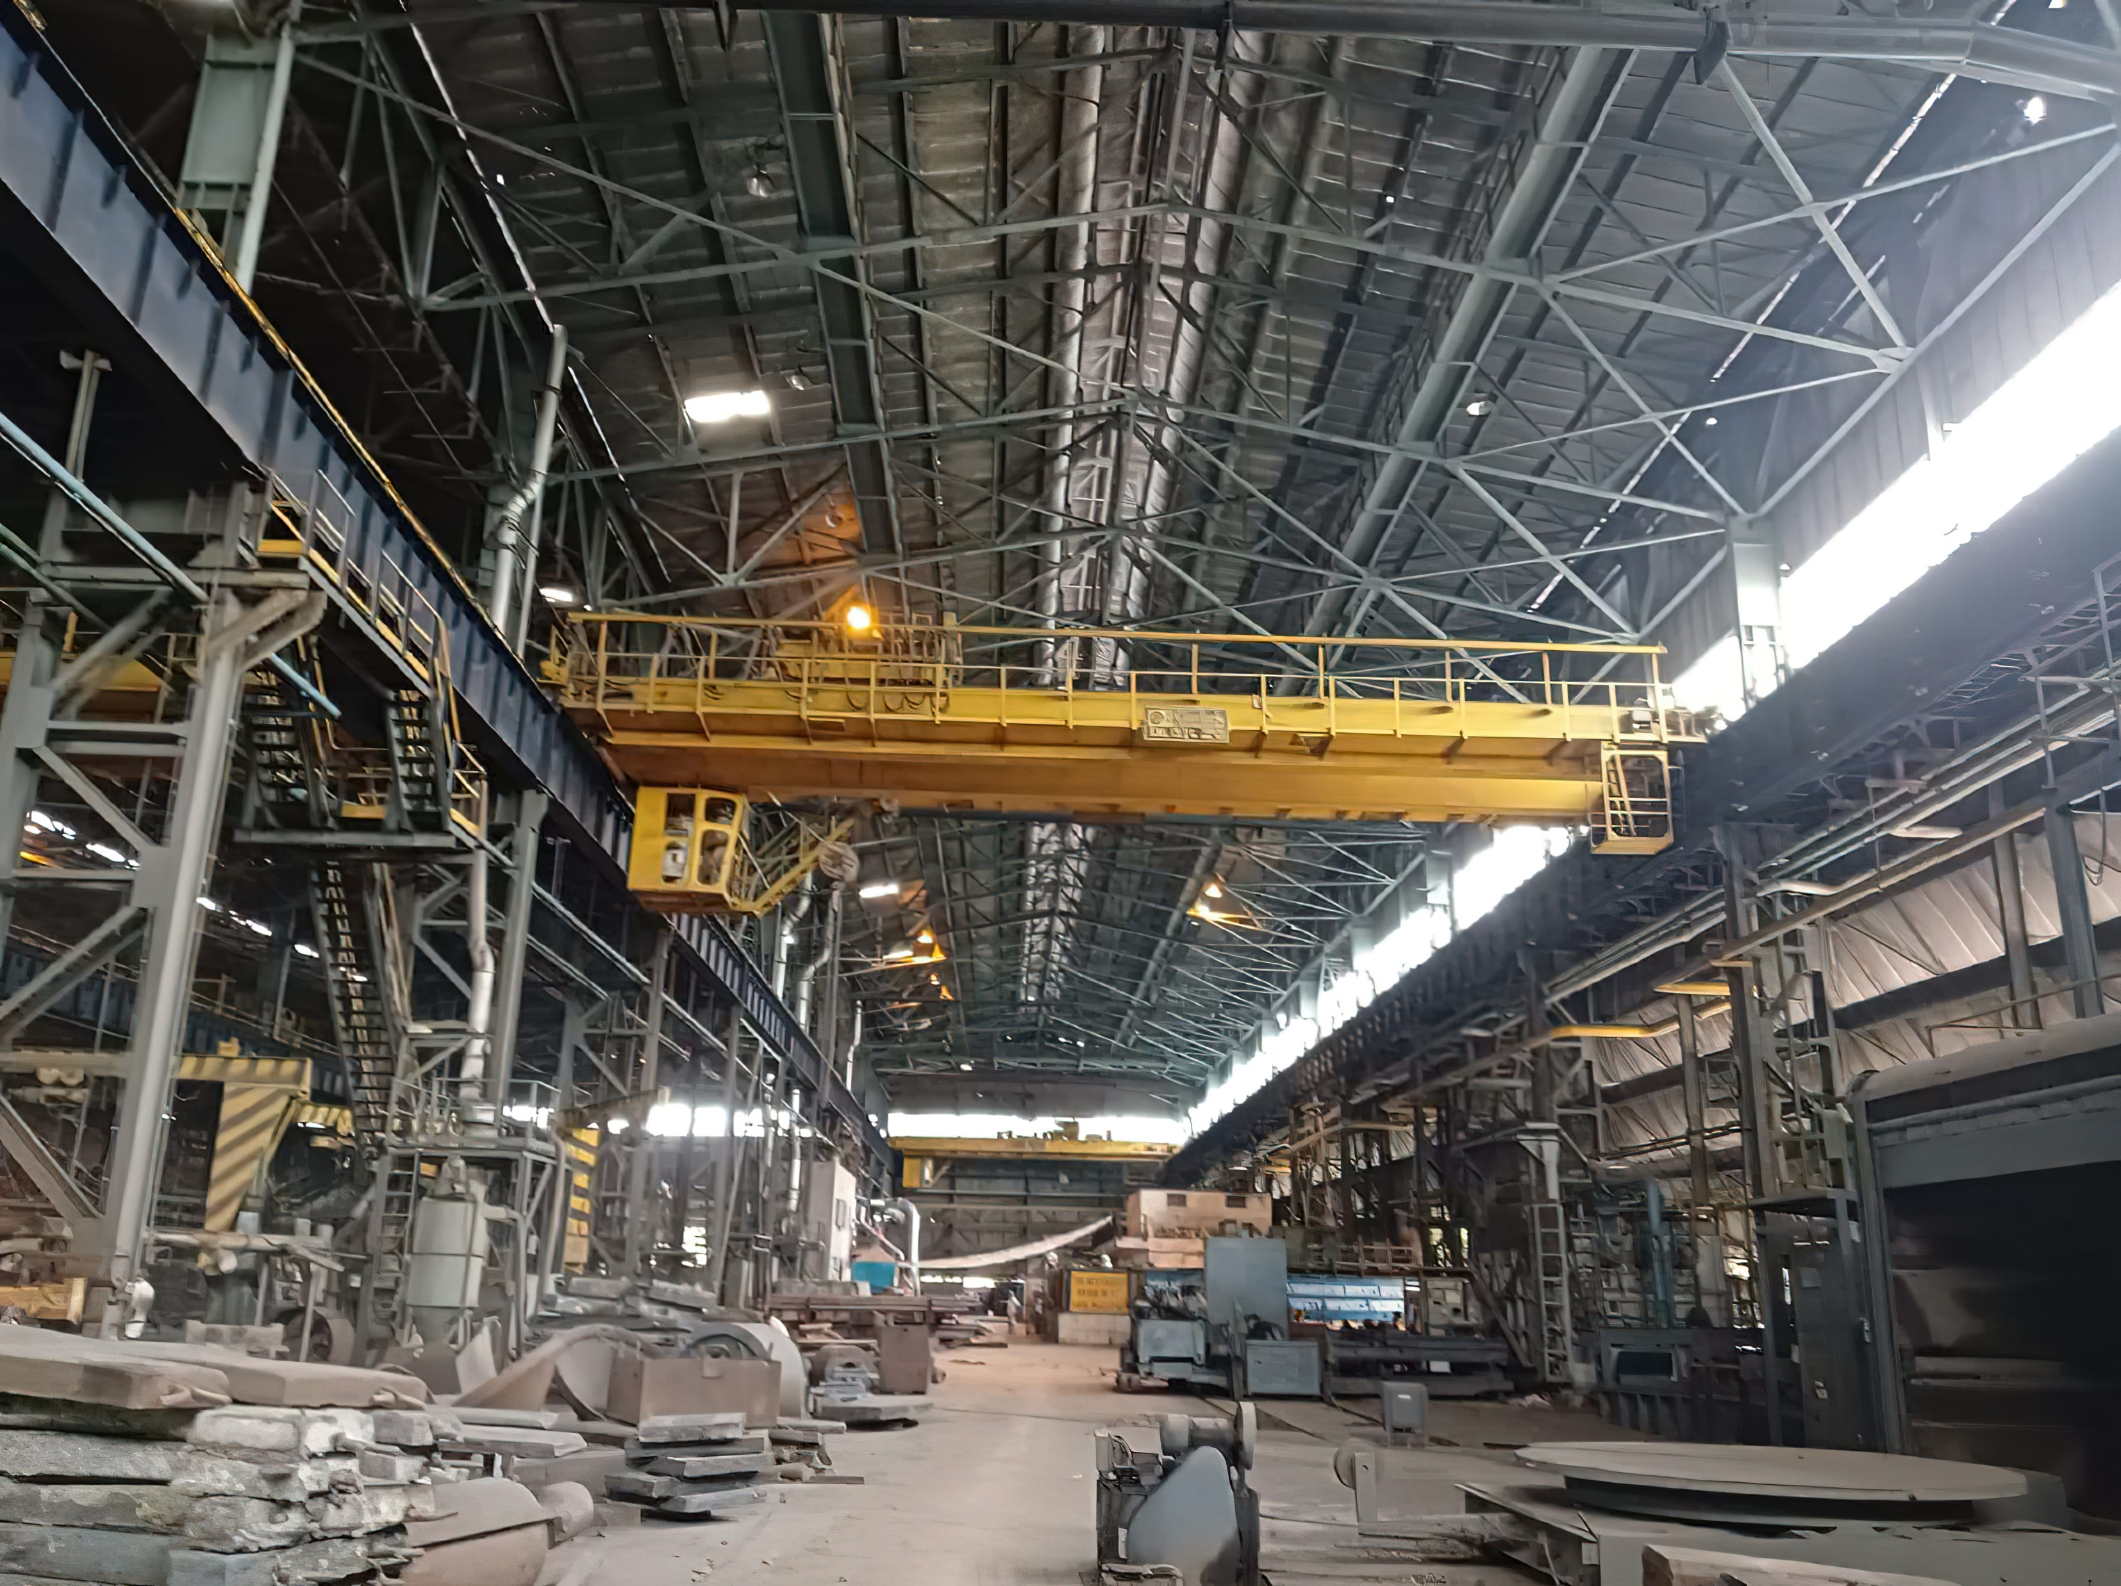
ENGINEERING SHOPS AND FOUNDRY (ES&F), RINL VIZAG
Engineering Shops & Foundry department is set up to meet the requirements of spares, repair of assemblies and reclamation of various jobs of different departments.
This complex consists of:
Central Machine Shop (CMS)
Steel Structural Shop (SSS)
Foundry
Forge Shop (FS)
Utility Equipment Repair Shop (UERS)

Slide 3

Main problems faced by the foundry inventory:
Shortages
Overstocking
Delays
Inaccurate pricing

Slide 4

OPTIMIZING INVENTORY MANAGEMENT IN FOUNDRY:
3 Routes taken:
ABC Analysis
EOQ Calculation
Reorder Point Calculation

Slide 5


ABC ANALYSIS

Slide 6
ABC ANALYSIS:
Used to identify the items that have the most significant impact on costs or sales
Steps:
Calculate the annual usage value for each item
(annual usage value = annual usage in units * price per unit)
→ After determining the annual usage value for each item, the items are ranked in descending order based on this value
→ Category A comprises the top 20% of items
→ Category B includes the subsequent 30% of items
→ Category C encompasses the remaining 50% of items

Slide 7

example:
Sl. No.: | Item Name | Units used annually | Price per unit | Annuage usage value
1 | Item 1 | 100 | 10 | 1000
2 | Item 2 | 90 | 9 | 810
3 | Item 3 | 80 | 8 | 640
4 | Item 4 | 70 | 7 | 490
5 | Item 5 | 60 | 6 | 360
6 | Item 6 | 50 | 5 | 250
7 | Item 7 | 40 | 4 | 160
8 | Item 8 | 30 | 3 | 90
9 | Item 9 | 20 | 2 | 40
10 | Item 10 | 10 | 1 | 10
A
B
C

Slide 8
EOQ CALCULATION

Slide 9
EOQ CALCULATION
EOQ: Economic Order Quantity
→ Widely used inventory management model that helps businesses determine the optimal order quantity for their inventory
→ Companies can minimize their inventory costs while ensuring that they have enough stock to meet customer demand

Slide 10
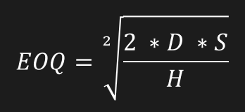
2 important factors:
Ordering costs: These include expenses associated with the process of placing and receiving inventory orders. This includes administrative tasks like preparing purchase orders, communication costs, such as contacting suppliers, and transportation costs for shipping the goods.
Holding costs: These refer to the expenses incurred for holding and storing inventory.
where
EOQ CALCULATION
EOQ: Economic Order Quantity
→ Widely used inventory management model that helps businesses determine the optimal order quantity for their inventory
→ Companies can minimize their inventory costs while ensuring that they have enough stock to meet customer demand
D: | Annual demand
S: | Ordering cost
H: | Holding cost

Slide 11
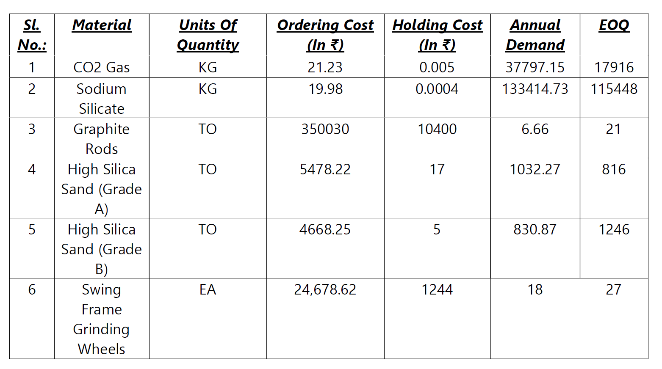

Slide 12

REORDER POINT CALCULATION

Slide 13
REORDER POINT CALCULATION
The reorder point is a concept used to determine when to place a new order for a particular item or product to ensure that there is sufficient stock on hand before it runs out.

Slide 14
To calculate reorder point, we need the following parameters:
→ Average Demand per day: This refers to the average quantity of a product that is consumed or sold per day.
→ Lead Time in days: Lead time is the duration between placing an order for a product and receiving it. It includes the time taken for processing the order, manufacturing or sourcing the product, and transportation or shipping.
→ Safety Stock: Safety stock is an additional inventory buffer that is held to account for uncertainties in demand and lead time. Safety stock serves as a contingency to avoid stockouts and maintain customer satisfaction

Slide 15
The formula for calculating reorder point is:
Reorder Point = (Average Demand per day × Lead Time in days) + Safety Stock

Slide 16
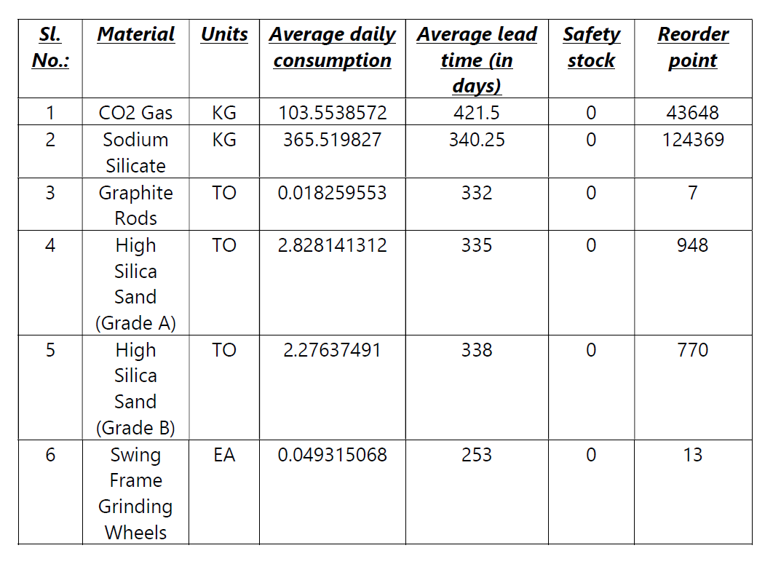

Slide 17
THANKS
Do you have any questions?
Contact:
dn.20u10719@btech.nitdgp.ac.in

